Slide 1
Please, use this full template. Do not just copy the ICSOBA logo from here into your company’s template.
TITLE OF PAPER
(ALL CAPITALS, ARIAL 32 BOLD)
Authors (Arial 24 bold, 1st Letter Capital)
Affiliation (Arial 28)
Presented by: Presenter’s Name (Arial 28 bold)

Slide 2
Presenter’s Bio
All Arial 24 bold
Name:
Degrees and date earned:
Company/Organization:
Present position:
Work experience:

Slide 3
Template
Here are the instructions for using this template:
The template displays the ICSOBA logo at the bottom and the date of the conference,
The characteristics of the template are: White background, black text Arial 28 (title), 24 (main text, 1st level), 20 (2nd level), 18 (3rd level) – 16 (4th level - minimum size). Black text is recommended (no pale grey, please), but occasional intense colour (no soft pale colour) could be used for enhancement. The title should be centred. Use Title Capitals rule.
Graphs should be large enough to have readable text and scales (this is rarely the case if multiple graphs per page are used – please avoid that). The graph title, axes titles and scales as well as the legend should use black script (no pale grey, please – change the default colours of Excel if they are pale grey).
The tables should have large enough lettering to be readable.
The slides have automatic numbering, please do not cover it with your logo.

Slide 4
Template
The logo at bottom right should be the logo of presenter’s company
(or nothing if the presenter wishes so). The logo can be inserted as
part of the template or used only on the title slide.
To insert the company logo as part of the template:
  Select “View” from the menu and then “Slide Master”,
  From the Slide Master view, select the first slide (which activates the Slide Master) and then click on logo box at bottom right. This will select the box seen at the bottom right which you have to delete, then copy your company logo from where you have it and paste it at the bottom right corner,
  If you do not want to insert your logo, delete the existing box,
  Click on menu Display → Normal mode,
  Start using the Template,
  Keep the webcam box at the top right while you are writing the slides. The space will be used to display your image for live recording of your speech. When you submit the presentation, you must delete the webcam box in the template.

Slide 5
Contents
(Arial 28 bold, capitals at beginning of words)
Xxx (Arial 24 bold)
Yyy
Zzz
Notes:
4

Slide 6
Introduction
Xxx (24 bold)
Yyy
  Aaa (20 bold or 20 not bold – mind that bold fonts are more visible)
  Bbb
    Mmm (18 bold or 18 not bold, minimum 16; any font < 16 will not be visible on the screen)
    Nnn
  CCC
Zzz

Slide 7
Example of readable table
The table shows main heat balance parameters:

Slide 8
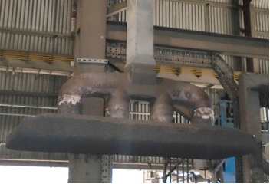
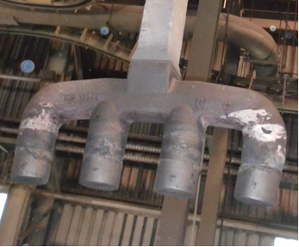
Example of Pictures
Due to good control on bath height there were rarely any rods rejected.
Anode rod rejection: An average of 0.29 % during 5 years.

Slide 9
Example of Graph
The iron concentration in metal for entire operational period:

Slide 10
Conclusions
Xxxx
Yyyy
Zzzz

